Slide 1
INTRODUCTION TO C++

Slide 2
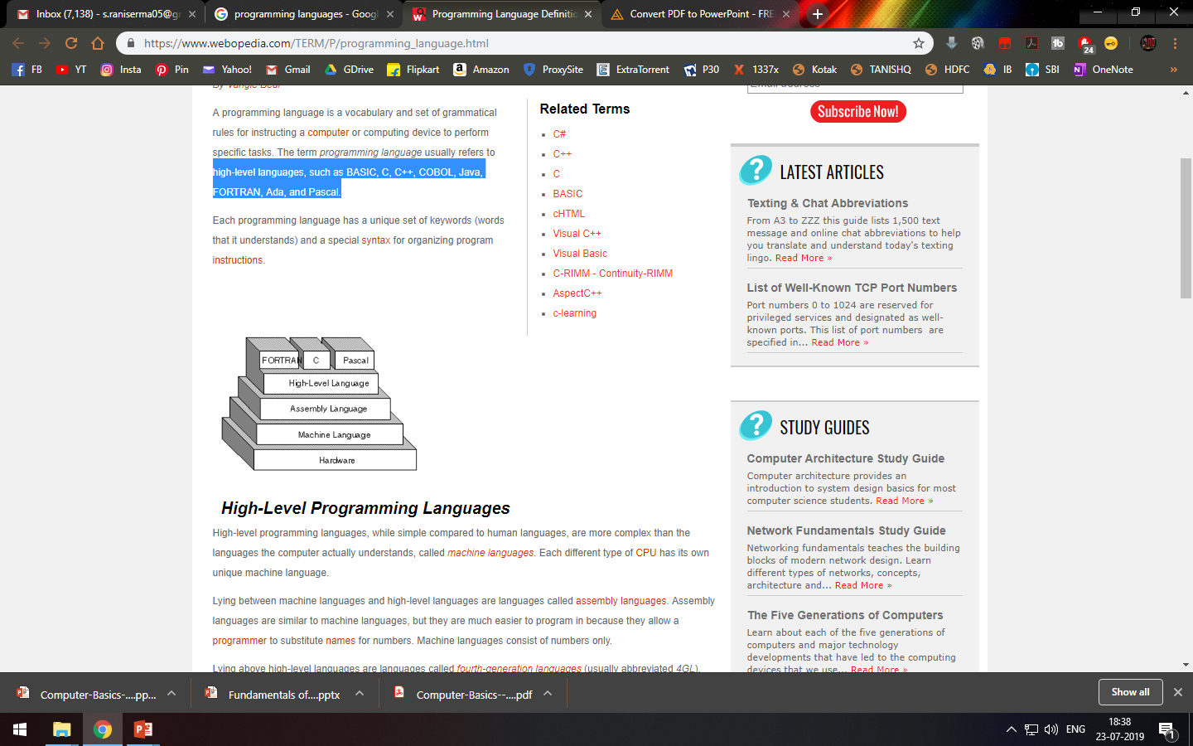
Programming language
A programming language is a set of grammatical rules for instructing a computer or computing device to perform specific tasks.
It is an high-level languages, such as BASIC, C, C++, COBOL, Java, FORTRAN, Ada, and Pascal.

Slide 3
Two types of Programming language:
1. Procedural Programming
2. Object Oriented Programming:

Slide 4
Procedural Programming:
Procedural Programming can be defined as a programming model which is derived from structured programming, based upon the concept of calling procedure.
There is no access specifier in procedural programming i.e. public, private etc.
Adding new data and function is not easy.
Procedural programming does not have any proper way for hiding data so it is less secure.
Examples: C, FORTRAN, Pascal, Basic etc.

Slide 5
Object Oriented Programming:
Object oriented programming can be defined as a programming model which is based upon the concept of objects. Objects contain data in the form of attributes(variables or data) and code in the form of methods(functions).
Object oriented programming have access specifiers like private, public etc.
Adding new data and function is easy.
Object oriented programming provides data hiding so it is more secure.
Examples: C++, Java, Python, C# etc.

Slide 6
OVERVIEW OF C++
C++ is a multi-paradigm that supports object-oriented programming.
It is an high level language →developed by Bjarne Stroustrup (Bell Labs, 1983)
started as extension to C by adding new features
It is used for programers to develop computer software.

Slide 7
Structure of C++
Header File
Main function
Variable declarations or code
Note:
Every statement ends with ;(semicolon).
Main function or function start and end with {} (curly braces)

Slide 8
Header File
Header files contain definitions of Functions and Variables, which is imported or used into any C++ program
E.g.
#include<iostream.h>
iostream stands for standard input output stream.
This header file contains definitions to objects like cin(input) and cout(output).
Explanation:
#include is pre-processor in C++
Header file have an extension ".h"

Slide 9
2. Main function
void main( )
{
}
3. Code or Variable declaration

Slide 10
E.g. :
Write a c++ program to display “Welcome to Bioinformatics” as output on screen
#include<iostream.h>
void main()
{
cout<<“Welcome to Bioinformatics”
}
Output:
Welcome to Bioinformatics

Slide 11
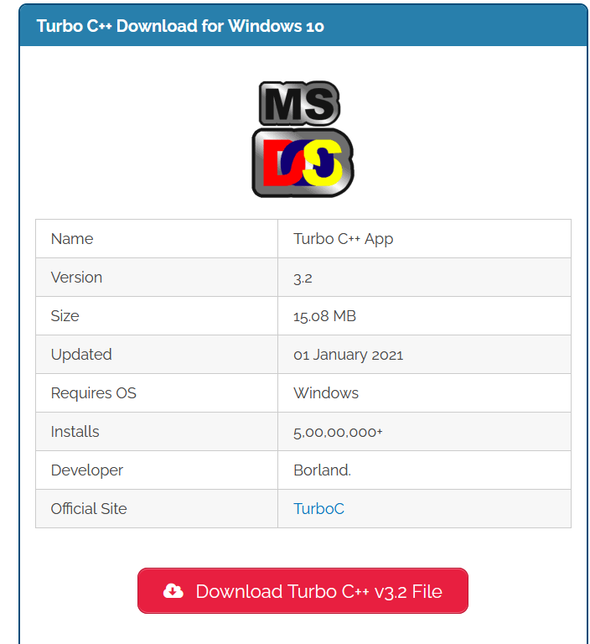
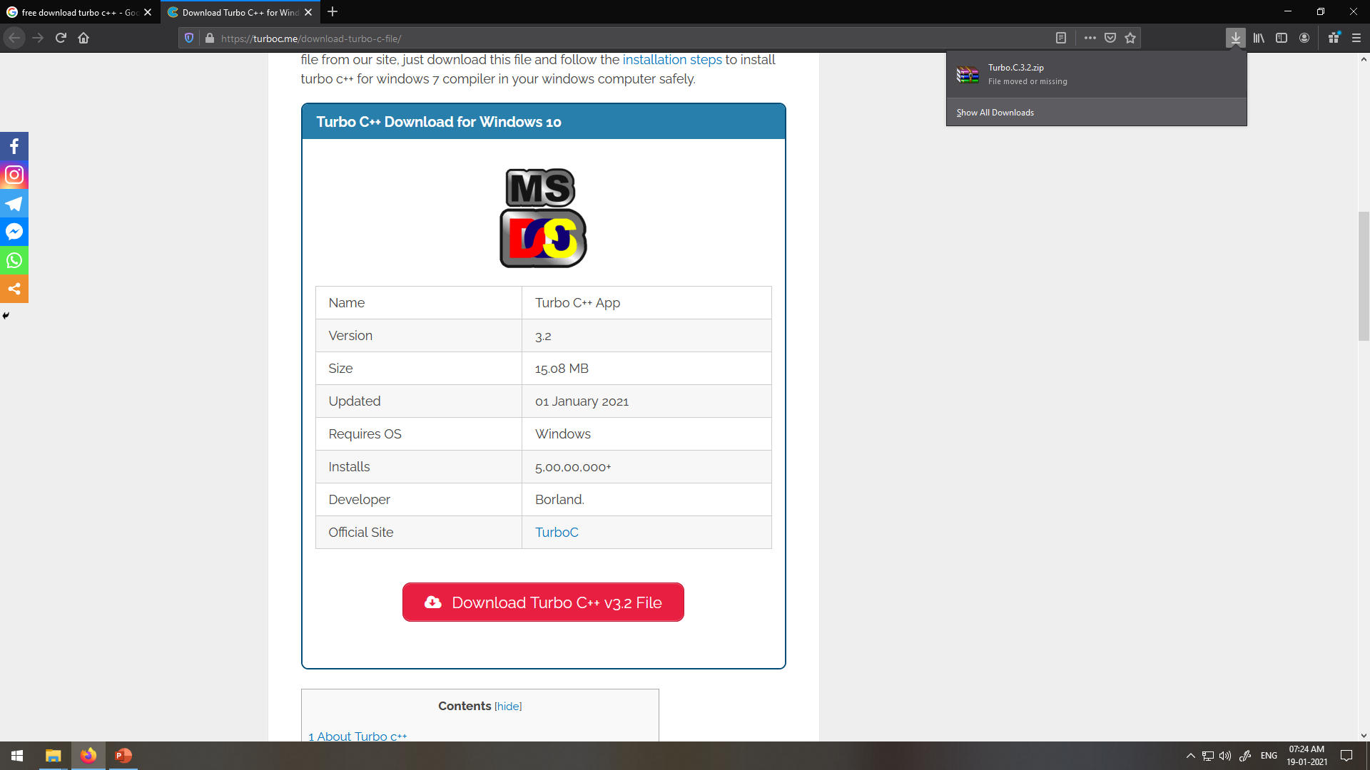
Install Turbo C++
https://turboc.me/download-turbo-c-file/

Slide 12
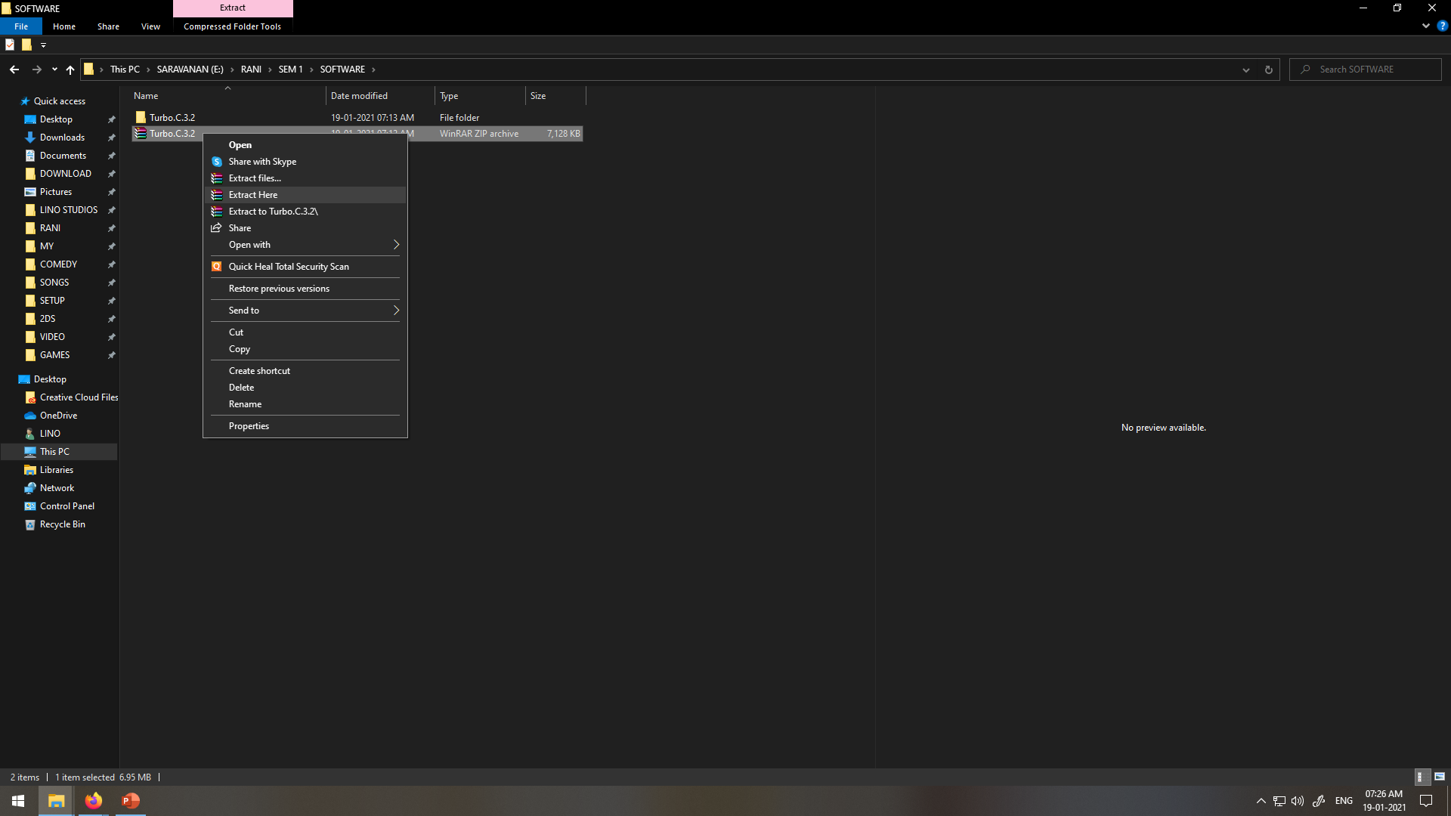
Right click on file→click on extract file

Slide 13
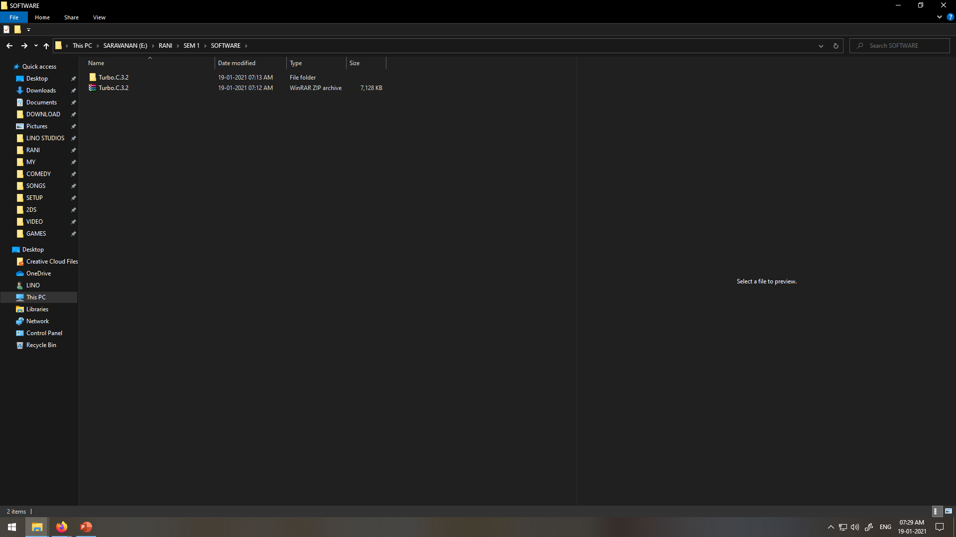
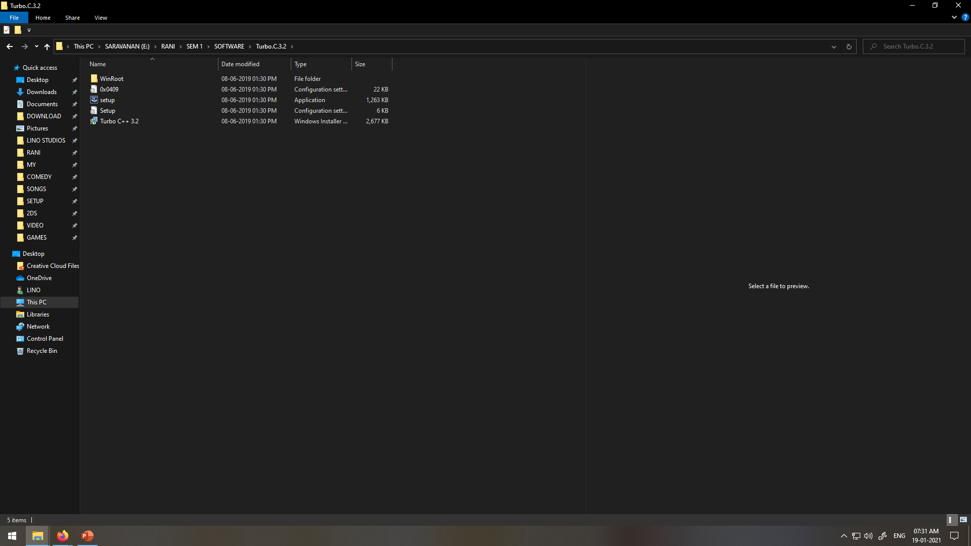
Open extracted folder(Double click on the folder)
Double click on the setup i.e application

Slide 14
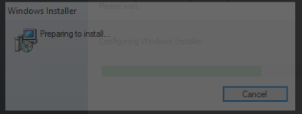
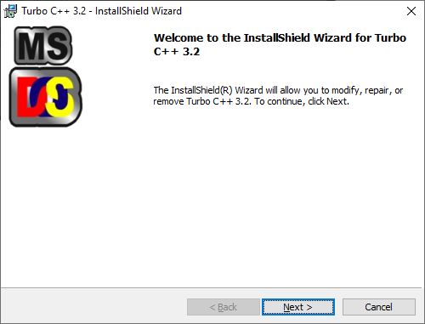
Select accept radiobutton and click install→ Click Launch

Slide 15
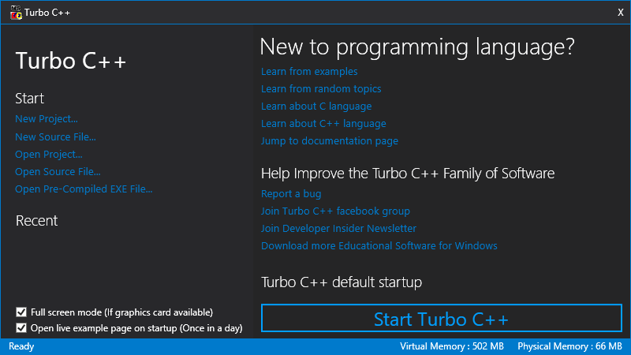

Slide 16
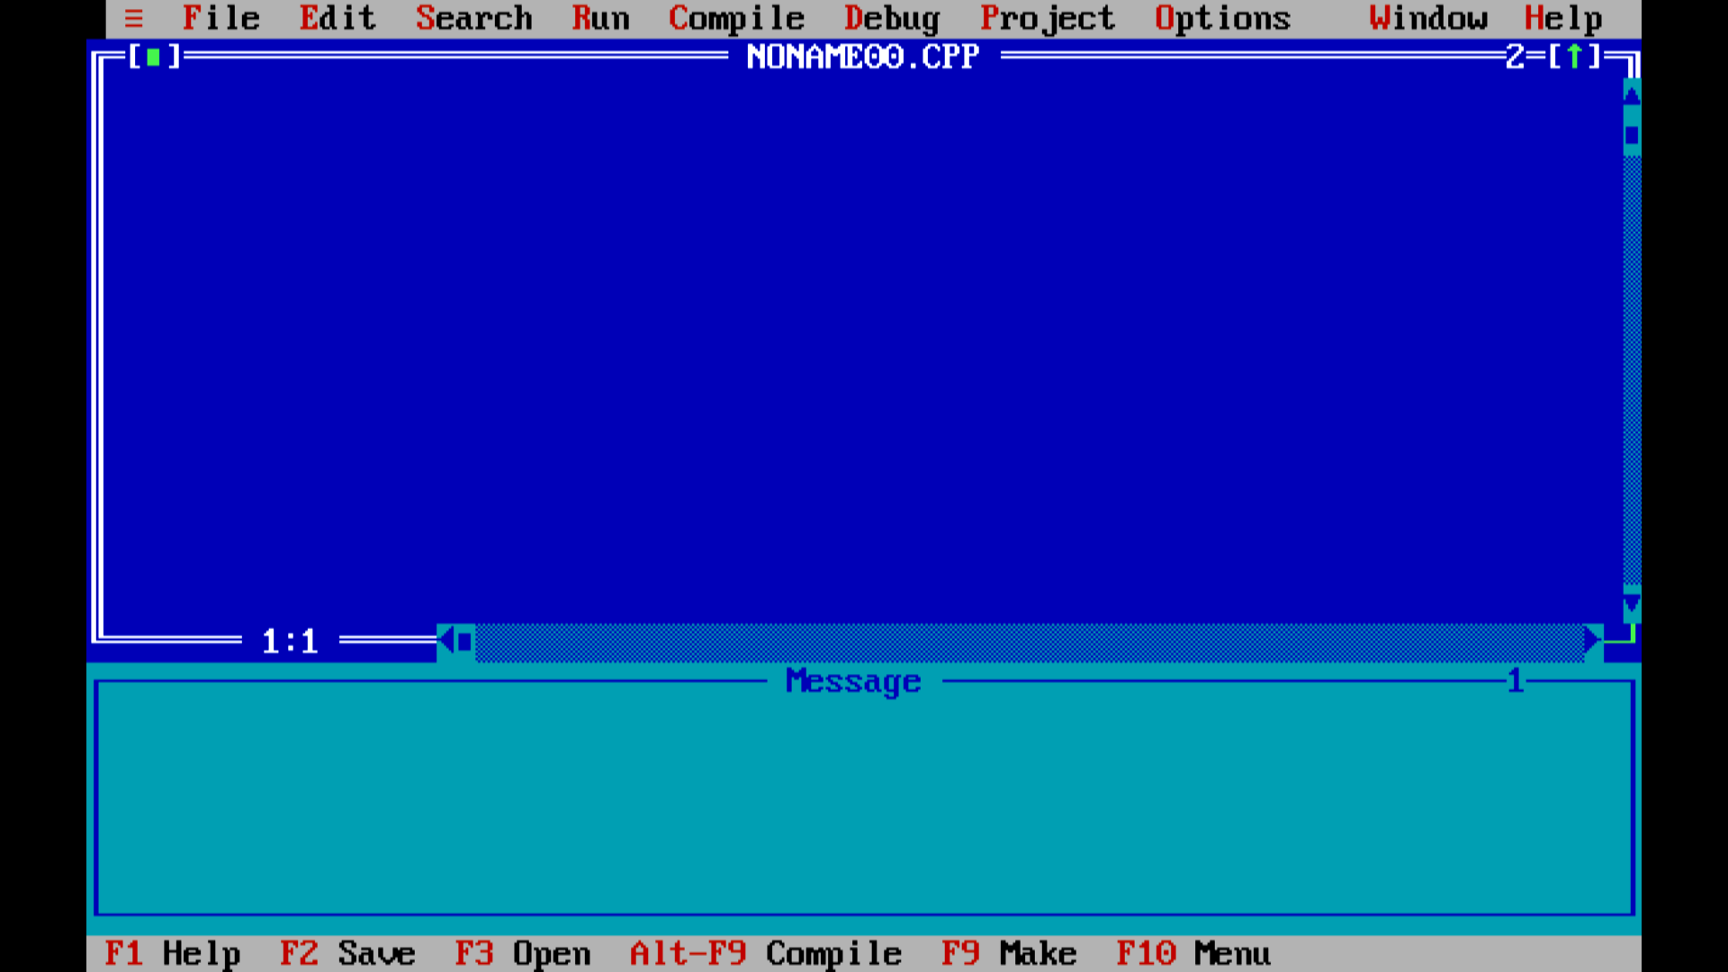

Slide 17
Tokens in C++
Each word or statement and punctuation is referred to as a token in C++.
Tokens are the smallest building block or smallest unit of a C++ program.
Keywords
Keywords are reserved words which convey special meaning to compiler or computer program, and its meaning cannot be changed.
The meaning and working of these keywords are already known to the compiler.

Slide 18
DATATYPES(kEYWORDS)
Keywords are the words that Convey Special meaning to the language compiler
The three basic data types are
INTEGER
These are whole numbers, both positive and negative
int
FLOATING POINT
These are numbers which contain fractional parts, both positive and negative.
float

Slide 19
CHARACTER
These are single characters.
char
Double
These are numbers which contain decimal values.
double

Slide 20
2. Comments in C++
Single line comment:
Syntax:
// a comment
Multi-line comment
/* a comment*/

Slide 21
2. VARIABLE(Identifiers)
Identifiers are names given to different entity such as variables, structures, and functions. Also, identifier names should have to be unique name.
Variables must be declared before they can be used in a program.
Used to Store values
Identifier naming conventions or rules
1. Only alphabetic characters, digits and underscores are permitted.
2. First letter must be an alphabet or underscore (_).
3. Identifiers are case sensitive.
4. Reserved keywords can not be used as an identifier's name.

Slide 22
Valid declaration:-
int newvar;
int _newvar;
int new_var;
Invalid declaration:-
int 1newvar;
int float;
int new-var;

Slide 23
Local variables
Only exist inside the specific function.
They are unknown to other functions.
They are recreated each time a function is executed or called.
Global variables
These variables can be accessed by any function in the program.
They do not get recreated if the function is recalled.

Slide 24
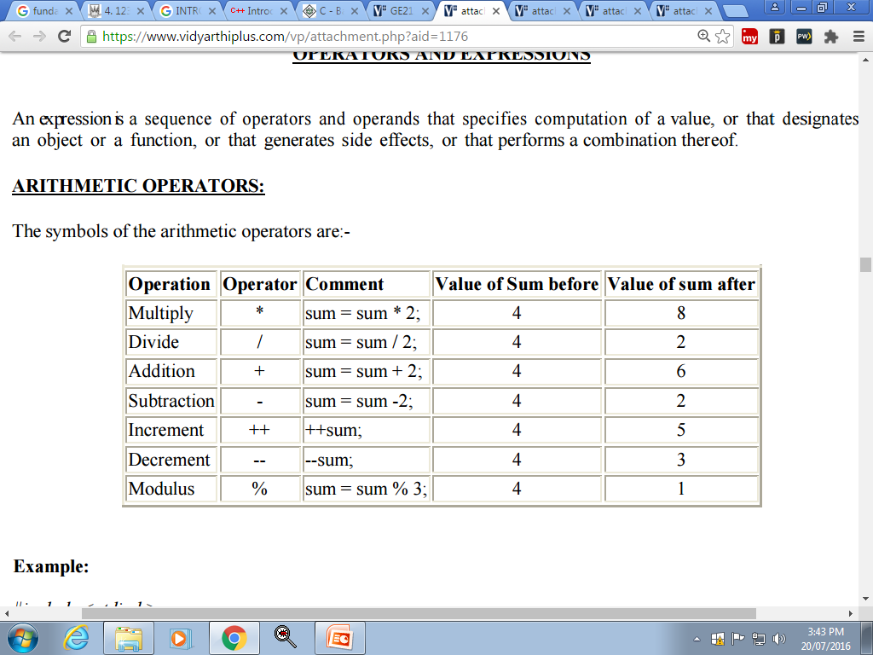
3. OPERATORS AND EXPRESSIONS
a. ARITHMETIC OPERATORS:
The symbols of the arithmetic operators are:-

Slide 25
b. THE RELATIONAL OPERATORS
These allow the comparison of two or more variables.
== equal to
!= not equal
< less than
<= less than or equal to
> greater than
>= greater than or equal to

Slide 26
c. THE I/O OPERATORS
Insertion(>>) :cin
Extraction(<<):cout

Slide 27
d. C++ Logical Operators
Logical operators are used to check whether an expression is true or false.
If the expression is true, it returns 1 whereas if the expression is false, it returns 0.
Operator | Example | Meaning
&& | expression1 && expression2 | Logical AND. True only if all the operands are true.
|| | expression1 || expression2 | Logical OR. True if at least one of the operands is true.
! | !expression | Logical NOT. True only if the operand is false.

Slide 28
Classwork:
C++ Program to Print Number Entered by User
C++ Program to Add Two Numbers
C++ Program to Find Quotient and Remainder SHALMON
C++ Program to Swap Two Numbers
Homework:
C++ Program to calculate average marks of five subjects entered by user. ANSH

